Slide 1
Intrusion:
Anomaly Detection
Intrusion:
Anomaly Detection
Project Team: Fiskewold, M., Mikkola, F.,
Nakae, J., Schwaiger, J., Thorne, J., Wyman, L.
Project Lead: Perez-Alvaro, J.

Slide 2
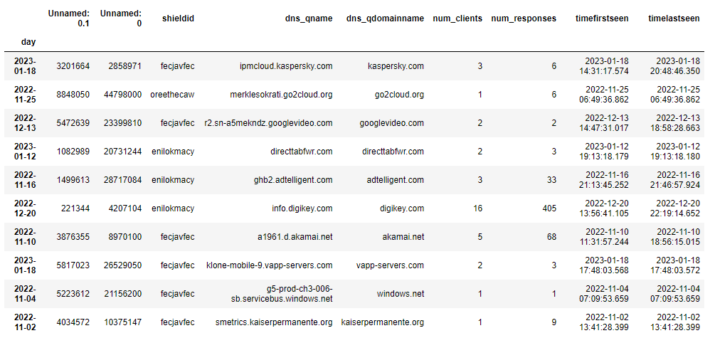
The Data
Notes:
Over the past several years, Intrusion noticed a trend in anomalous web traffic rates for multiple web domains, in particular large spikes in traffic and then a return to very low traffic
Our team was tasked with investigating the DNS data and using ML and other techniques to identify and possibly predict these anomalies
The data we recieved represented an aggregated summary of DNS logs per site, per day. This data was collected between the months of October 2022 and January 2023
What could have made the data better to begin with
What could we have known

Slide 4
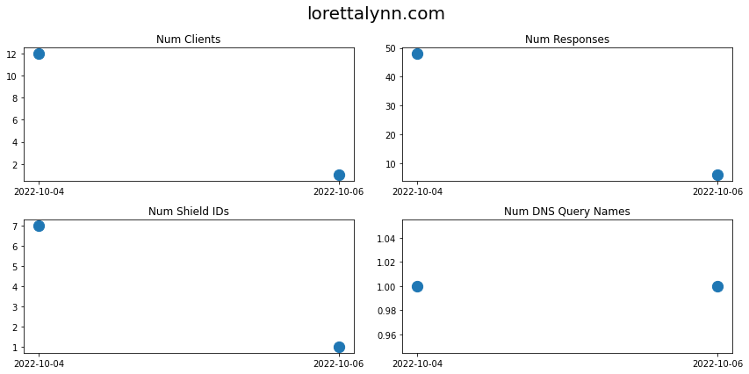
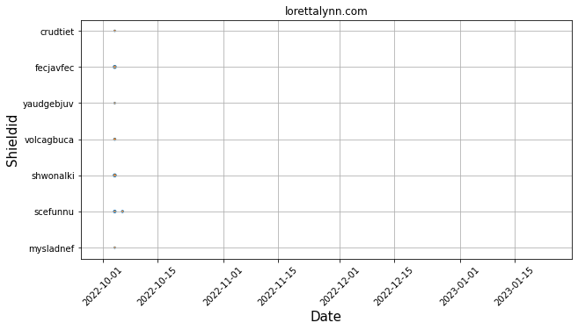
Finding Anomalies: Attempt 1
Shield-ID occurrences
Counted how many days each domain name appeared in the dataset.
Identifying a list of 200 anomalies
But had some limitations:
Did not pick up anomalies that occurred on specific days, or anomalies that did not fit the criterion defined by shield-ID.
Notes:
To identify anomalies in the dataset, the team used the criterion of a domain name that appeared on no Shield-IDs and then suddenly appeared on multiple Shield-IDs at once.
To isolate such domain names, the team grouped the data by domain name, day, and shield-ID, and counted how many days each domain name appeared in the dataset.
This approach was effective in identifying a list of 200 anomalies, but had some limitations. For example, it did not pick up anomalies that occurred on specific days, or anomalies that did not fit the criterion defined by shield-ID.
Here is one anomaly that this method detected. This was a particularly interesting example because it was not necessarily a “bad” anomaly. But instead was just a spike on the day that Loretta Lynn passed away.

Slide 5
Finding Anomalies: Attempt 2
The second type of anomalies were identified by examining the shape of the example anomaly given in 'beside.media'.
The traffic pattern of 'beside.media' showed a distinctive shape with low traffic for a long period, followed by a sudden spike, then slowly dying down to no traffic.
A linear regression program was run using the data from 'beside.media' to find similar websites, but it only found sites with traffic at the exact same time as 'beside.media'.
The solution was found by using the tslearn library and the dynamic time warping function (dtw) to compare websites with traffic that occurred on completely different days.
The dtw function was used to compare all websites with 'beside.media' and only those with a dtw value below a specific threshold were saved, which returned a lot of websites containing a good amount of seemingly anomalous websites, such as '123w0w.com'.

Slide 6
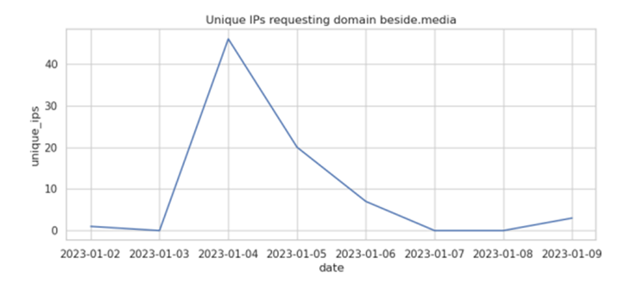
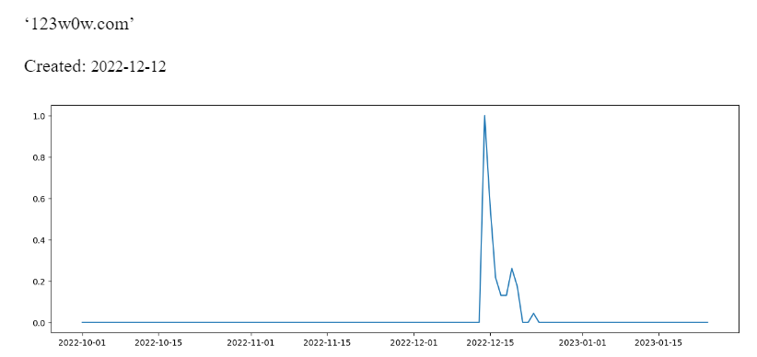
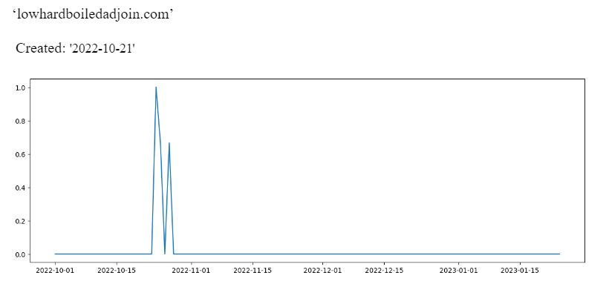
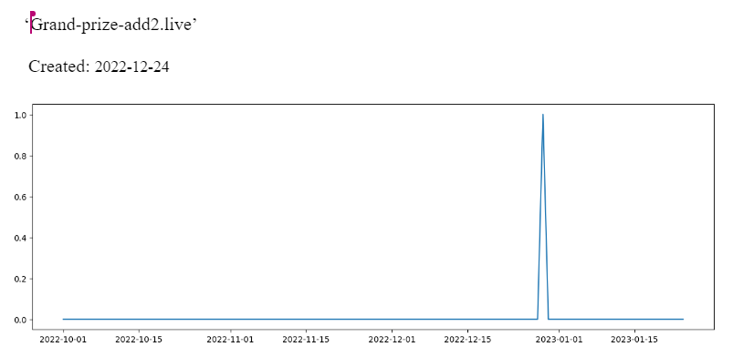

Slide 7
Model 1: Classification
Initial attempts
Feature Engineering
Additional Features
Balancing
Random Forest
XGBoost
Hyperparameter Tuning
Notes:
Due to the sparisty of anomalies, our initial Models performed very poorly, classifying all data as not anomalies.
To create a more robust and usable dataframe we added additional columns to the data, including top million rank, time existed (days between created, expires), and tld
We also balanced the data by first splitting it into training and testing sets and then duplicated rows of anomalies and randomly selected non-anomalies and removed them.
Once we had a more robust and balanced dataset we built Random Forest and XGBoost (good with large datasets, parallel processing) model pipelines.
We used Optuna for hyperparameter tuning

Slide 8
Results
XGBoost:
Unbalanced Data
[2024000, 41441]
[0 , 1363]
2% false pos
Single Day (unbalanced)
[44233, 406]
[0 , 20]
.1% false pos
Notes:
XGBoost performed the best. We trained the model on the balanced data and then tested on the entire data unbalanced, and a single day unbalanced and these were our results

Slide 9
Model 2: (Domain, Day) Anomalies
Objective: Find anomalous instances of (Domain, Day) using daily count columns {num_clients, num_responses, num_shieldids}.
Step 1: Get a statistical anomaly score for each (Domain, Day)
Step 2: Improve our anomaly scores by classical ML methods
Consider num_clients column first.
Classify domains into a ‘client_sum_group’ by summing num_clients by domain.
For each client_sum_group, associate each (Domain, Day) with the probability of observing a value as large as that observation.
Relatively large observation in a relatively small sum group → anomaly
Do the same for num_responses, num_shieldids.
Normalize for daily traffic, creating a final anomaly score column with the interaction:
prob_obs_num_clients^{1/2} X prob_obs_num_responses^{1/2} X prob_obs_num_shieldids^{1/2}

Slide 10
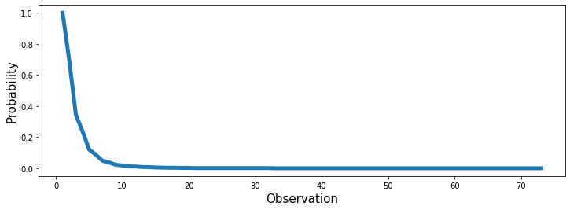
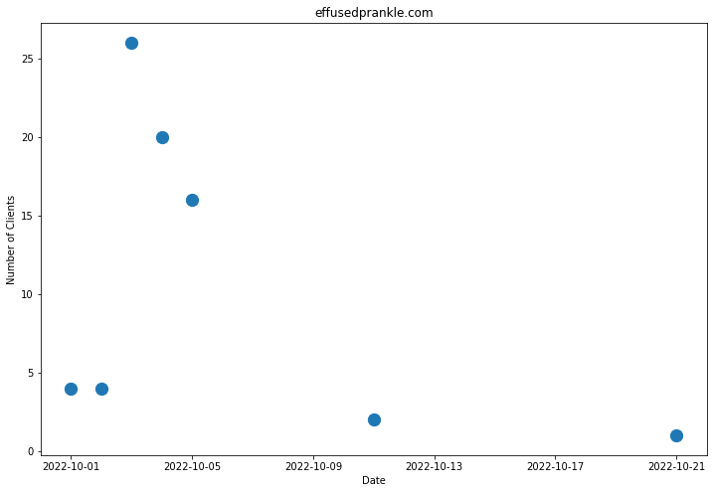

Model 2: (Domain, Day) Anomalies
num_clients anomaly: ‘effusedprankle.com’
‘effusedprankle.com’ has num_clients observations O={4,4,26,20,16,2,1}.
Place in client_sum_group 73 with other domains that sum to 73.
As o_{i} gets larger for o_{i}={1,2,...,73}, P(o>o_{i}) will get smaller.
For client_sum_group 73, P(o>2)=.693 is considered normal
For client_sum_group 73, P(o>26)=.001 is considered anomalous

Slide 11
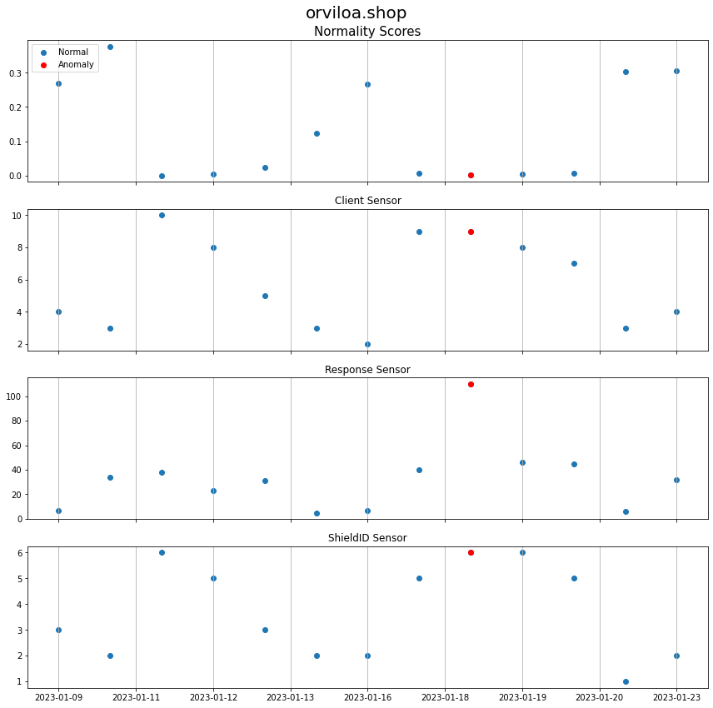
Model 2 Results
Promising Statistics-based model:
Basic model to implement (only uses initial data)
Uses historical data to establish baselines
Has some known domains, but otherwise VERY robust
Output is anomaly likelihood rather than binary
Room for improvement:
Choosing a balanced number of sum groups (currently 300-500)
Unbalanced data leads to more anomalies on days with more sensor traffic
Arbitrary anomaly probability cutoffs could lead to missing instances (.01)
Arbitrary interaction function that determines anomaly score
What to do next:
Use this classification, train a classic ML model with other columns, improve the first attempt of sorting the anomaly scores for each (Domain, Day).
SGDRegressor in works: already shows improved anomaly quality (reinforced anomaly scores)

Slide 12
Discussion/Future Projects
Computational Limitations:
Data size (reading and computing)
Data sparseness (pattern detection)
Identifying desirable “malicious” anomalies
Combine Isolation Forests with PCA or t-SNE
Robust Subspace Recovery Autoencoder Layer (RSR Neural Network)

